Slide 1
MARKETING ANALYTICS I
SESSION 8:
PREFERENCE BASED SEGMENTATION
Professor Sonnier
Texas MSBA Program
Fall 2022

Slide 2
SEGMENTATION
Behavioral Bases for Segmentation
Revealed Preference Data
What customers actually do
Stated Preference Data
What customers say they will do

Slide 3
SEGMENTATION
Using Behavioral Data
Rule of thumb
Based on past behavior use simple statistics (no models) to predict future behavior
Heuristics
Create models that use behavior as a source of model building
The analyst decides what behavior to model
Model Driven
Notes:
This concept actually stems from John Hagel's and Marc Singer's HBR and McK Quarterly article "Unbundling the Corporation". Their hypothesis is that decreasing interaction costs will drive corporations (or at least those intent on staying competitive) to disaggregate according to the above overall "functions".
We introduce this concept to business unit strategy to help teams focus on those functions of the client and their competitors which are most crucial on the competitive battlefield. Thus most investigative effort will be spent where it really matters. In the pyramid introduced above we give some suggestions which frameworks/tools/concepts can be helpful for further analysis depending on the driver(s) of the business.
Of course many business units will have more than one value driver. A pharmaceutical BU, for example, might very well be competing as a customer relationship business (targeting its sales force for maximum impact with physicians) as well as competing as an innovation business (developing and managing its drug pipeline). Both drivers of the business will need to be examined by the team. In the spirit of Hagel and Singer this might also be the starting point to investigate possibilities to unbundle the functions of the BU or the corporation and have the client focus on the game he's prepared to play best at.

Slide 4
SEGMENTATION
Using Behavioral Data
Rule of thumb
Based on past behavior use simple statistics (no models) to predict future behavior
Heuristics
Create models that use behavior as a source of model building
The analyst decides what behavior to model
Model Driven
Notes:
This concept actually stems from John Hagel's and Marc Singer's HBR and McK Quarterly article "Unbundling the Corporation". Their hypothesis is that decreasing interaction costs will drive corporations (or at least those intent on staying competitive) to disaggregate according to the above overall "functions".
We introduce this concept to business unit strategy to help teams focus on those functions of the client and their competitors which are most crucial on the competitive battlefield. Thus most investigative effort will be spent where it really matters. In the pyramid introduced above we give some suggestions which frameworks/tools/concepts can be helpful for further analysis depending on the driver(s) of the business.
Of course many business units will have more than one value driver. A pharmaceutical BU, for example, might very well be competing as a customer relationship business (targeting its sales force for maximum impact with physicians) as well as competing as an innovation business (developing and managing its drug pipeline). Both drivers of the business will need to be examined by the team. In the spirit of Hagel and Singer this might also be the starting point to investigate possibilities to unbundle the functions of the BU or the corporation and have the client focus on the game he's prepared to play best at.

Slide 5
SEGMENTATION
Behavioral Bases for Segmentation
Revealed Preference Data
What customers actually do
Stated Preference Data
What customers say they will do

Slide 6
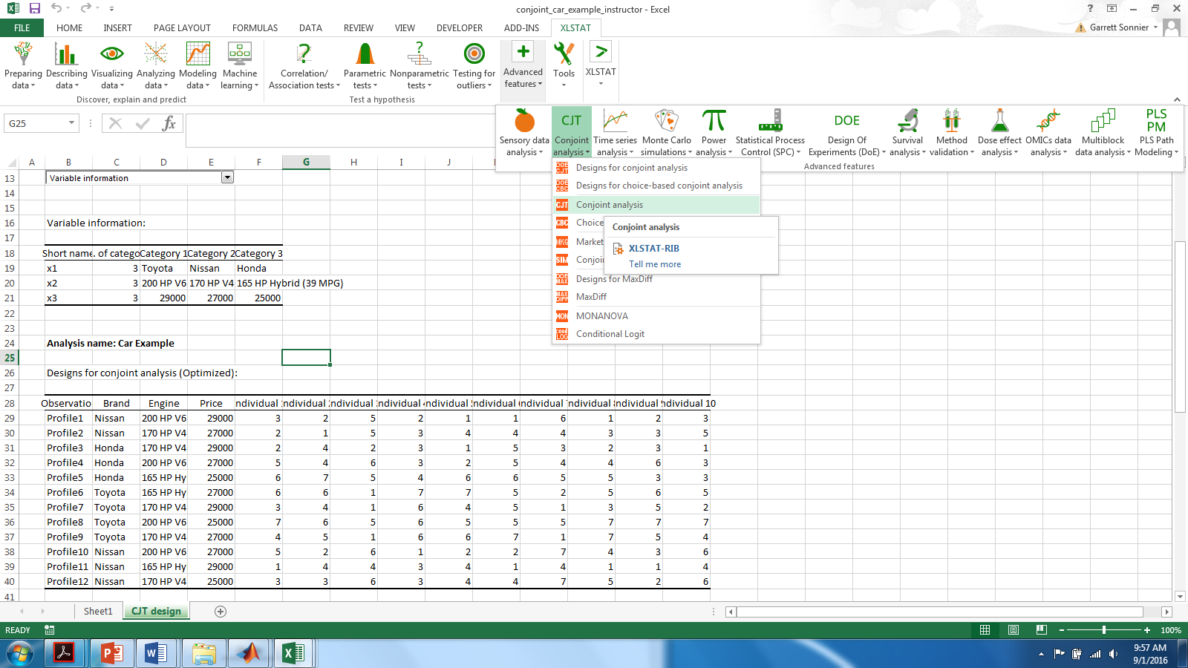
CONJOINT ANALYSIS
Models for Stated Preference Data
Respondents Rate Product Profiles

Slide 7
CONJOINT ANALYSIS
Data for Model Estimation: Example for Respondent 4
We can use OLS regression analysis to estimate the beta coefficients

Slide 8
CONJOINT ANALYSIS
Let’s Look at Our Data: Respondent #4
The y data across individuals and tasks
The matrix of betas from person-by-person OLS regression

Slide 9
CONJOINT ANALYSIS
Let’s Look at Our Data: Respondent #6
The y data across individuals and tasks
The matrix of betas from person-by-person OLS regression

Slide 10
CONJOINT ANALYSIS
Let’s Look at Our Data: Respondents #4 and #6
By estimating the models one-by-one Respondent #4 and #6 are not connected
How could we connect them?
We could pool over all the respondents and estimate one regression
In the model above there are no i subscripts on the betas

Slide 11
REGRESSION ANALYSIS
PICK A LINE…HERE’S A LINE THROUGH THE MEAN
y
error
error
x

Slide 12
REGRESSION ANALYSIS
PICK A LINE…HERE ARE TWO OTHER POSSIBILITIES
Which line do I choose?
error for line 1
y
error for line 2
x

Slide 13
CONJOINT ANALYSIS
Data Pooled Over All Respondents

Slide 14
CONJOINT ANALYSIS
Data Pooled Over All Respondents

Slide 15
CONJOINT ANALYSIS
Data Pooled Over All Respondents
Is an NT by 1 column vector of purchase interest ratings
Is an NT by K column matrix of independent variables (of which there are K)
Is a K by 1 column vector of parameters (to be estimated)

Slide 16
CONJOINT ANALYSIS
Data Pooled Over All Respondents
Is an NT row by 1 column vector of purchase interest ratings
Is an NT row by K column matrix of
independent variables (of which there are K)
Is a K by 1 column vector of
parameters (to be estimated)

Slide 17
HOW TO SOLVE IT
Finding Betas that Minimize SSE
Option 1: Outsource the job to your computer
Option 2: Do it yourself
Public Service Announcement: I will not ask you to derive this on an exam.

Slide 18
CONJOINT ANALYSIS
Data Pooled Over All Respondents
Is an NT row column vector of purchase
interest ratings
Is an NT row by K column matrix of
independent variables (of which there are K)
Is a K by 1 column vector of
parameters (to be estimated)

Slide 19
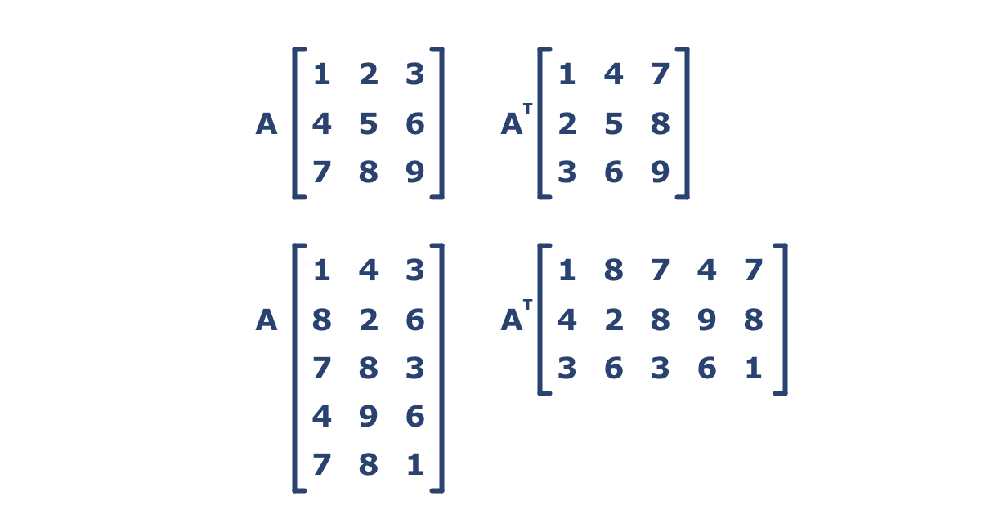
CONJOINT ANALYSIS
How to Compute Beta from X and y: Example
Read in the data
10
22
8
17
6

Slide 20
CONJOINT ANALYSIS
How to Compute Beta from X and y: Example
Take the transpose of the X matrix
Compute X’X
Compute the inverse of X’X

Slide 21
CONJOINT ANALYSIS
How to Compute Beta from X and y: Example
Compute X’y
10
22
8
17
6
Compute (X’X)⁻¹(X’y)
Behold results

Slide 22
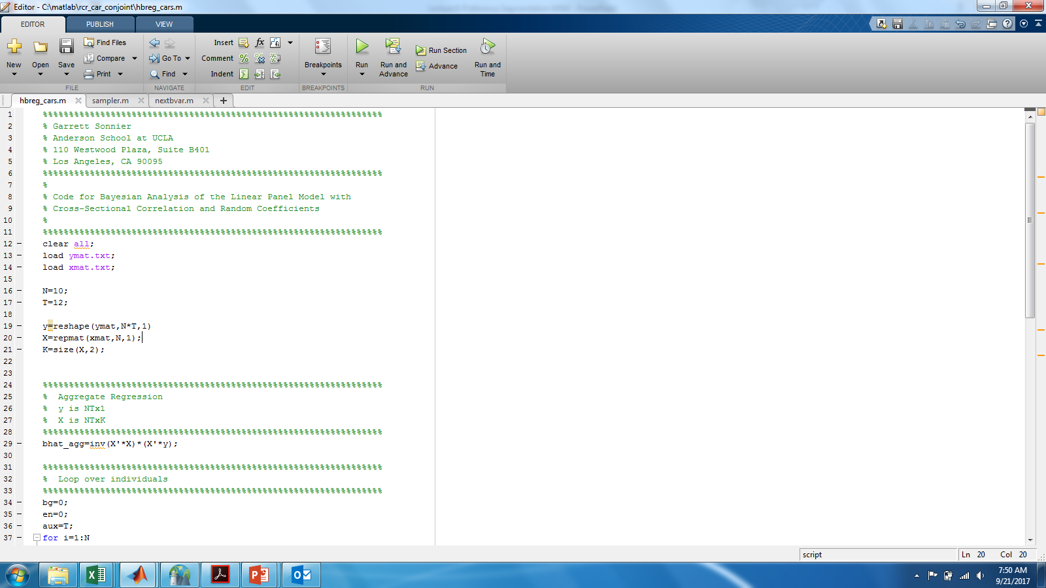
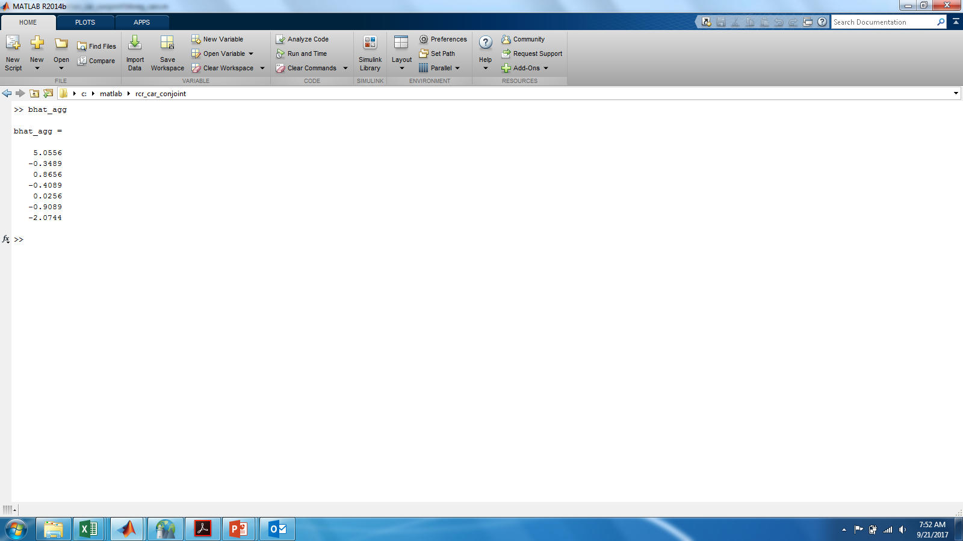
CONJOINT ANALYSIS
Data Pooled Over All Respondents

Slide 23
CONJOINT ANALYSIS
Data Pooled Over All Respondents
Pooled Model
Uses all NxT=120 observations

Slide 24
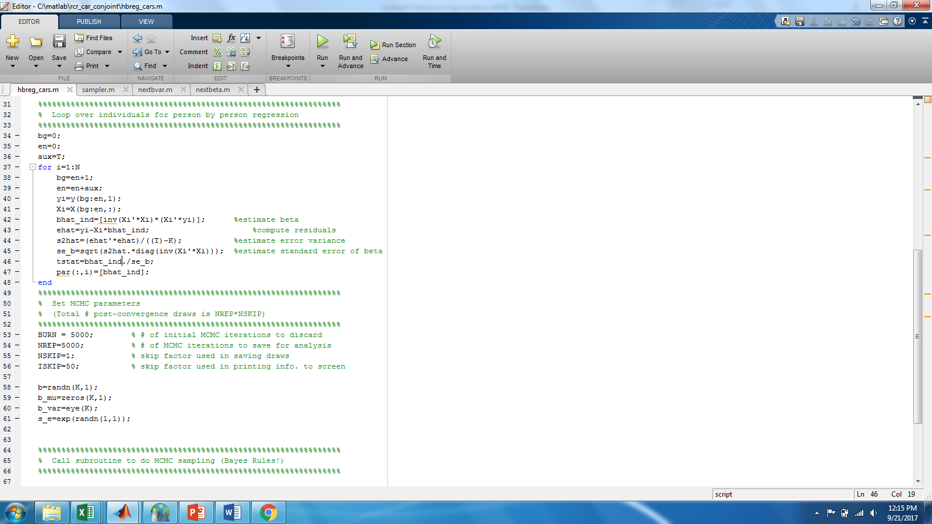
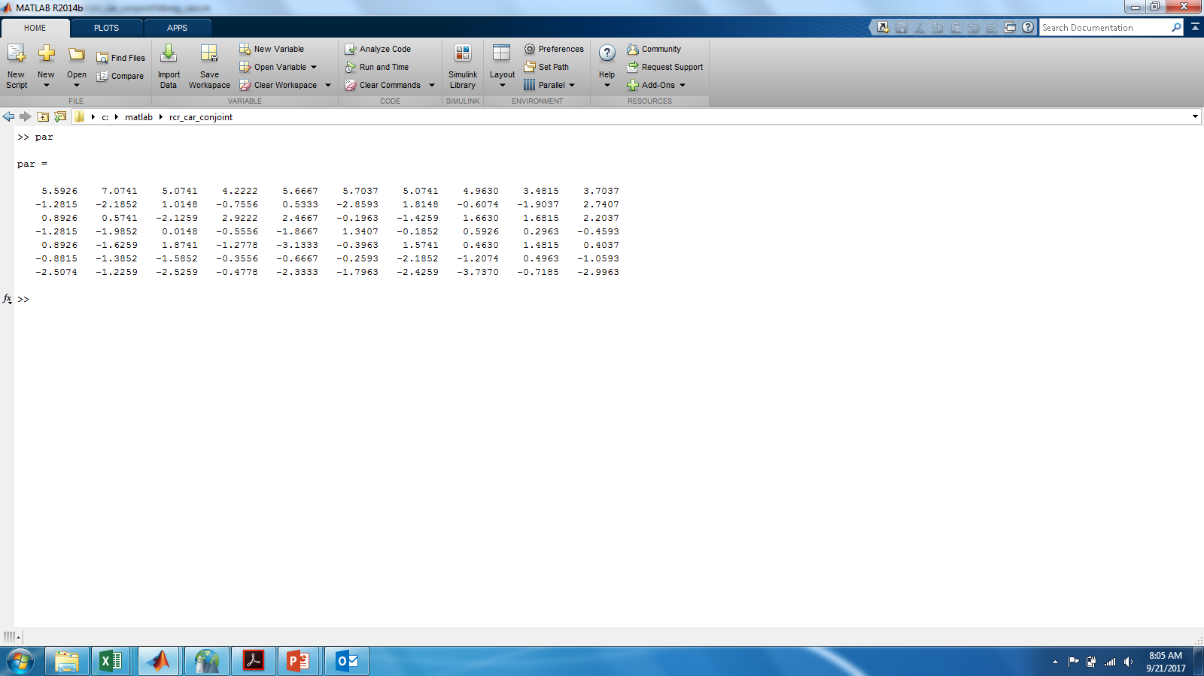
CONJOINT ANALYSIS
Looping Over Respondents for Individual-Level Betas

Slide 25
CONJOINT ANALYSIS
Data Pooled Over All Respondents
Individual Model
Each model has only T=12 observations!

Slide 26
CONJOINT ANALYSIS
Data Pooled Over All Respondents
Pooled Model
Uses all NxT=120 observations
WHICH ONE SHOULD WE CHOOSE? WHY?
Individual Model
Each model has only T=12 observations!

Slide 27
CONJOINT ANALYSIS
Combining Individual and Aggregate Information
Individual Model
Each model has only T=12 observations!
How would you summarize and describe the beta coefficients above?
In words, each individual level set of betas comes from a normal distribution with a mean and covariance

Slide 28
CONJOINT ANALYSIS
Combining Individual and Aggregate Information
Example with 10 people

Slide 29
A RESPONSE MODEL WITH INDIVIDUAL LEVEL COEFFICIENTS
Mathematical Intuition
You observe some data you believe comes from a model
You have some beliefs about the parameters of your model
Your inferences about beta should combine the data and your prior beliefs

Slide 30
A RESPONSE MODEL WITH INDIVIDUAL LEVEL COEFFICIENTS
Graphic Model
Individual level parameters informed by two sources of information
Data only for the individual (i.e., the data likelihood)
Data common to all individuals (i.e., the prior likelihood)

Slide 31

A RESPONSE MODEL WITH INDIVIDUAL LEVEL COEFFICIENTS
How to Estimate this Model
Take Marketing Analytics II

Slide 32
A RESPONSE MODEL WITH INDIVIDUAL LEVEL COEFFICIENTS
How to Estimate this Model
The likelihood of your observed data given your parameters
X
Your prior beliefs about the value of the parameters
The posterior distribution of the parameters given the data

Slide 33
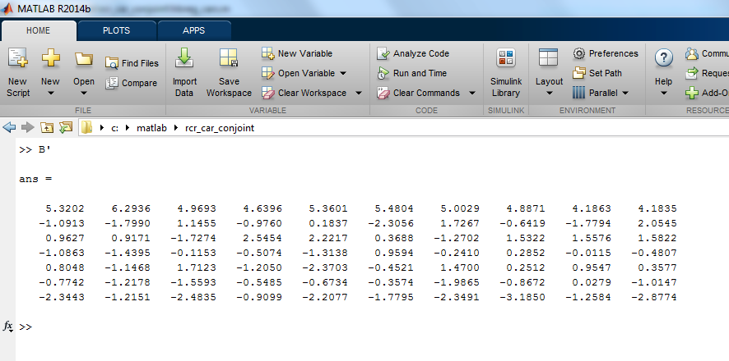
A RESPONSE MODEL WITH INDIVIDUAL LEVEL COEFFICIENTS
Hierarchical Bayes…The Best of Both Worlds
Are these better than person by person OLS?
If yes, in what sense?
Can we do person by person estimation of discrete choice models?

Slide 34
SEGMENTATION
Behavioral Bases for Segmentation
Revealed Preference Data
What customers actually do
Stated Preference Data
What customers say they will do

Slide 35
WHAT ABOUT REVEALED PREFERENCES
A Simple Model for Elasticities
We observe t=1,…, 26 weeks of sales and prices for each stores
There are j=1,…,19 stores

Slide 36
REVEALED PREFERENCES
Elasticities
Model in Logs

Slide 37
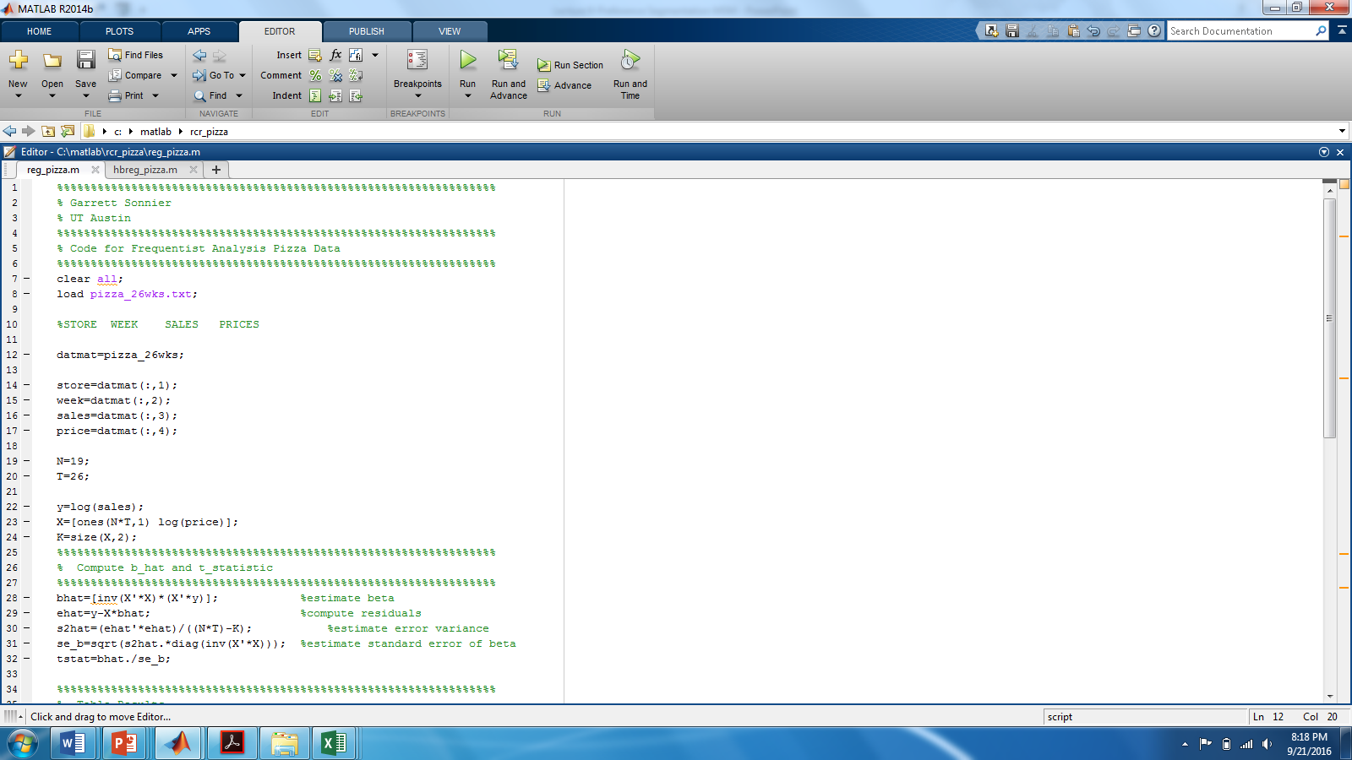
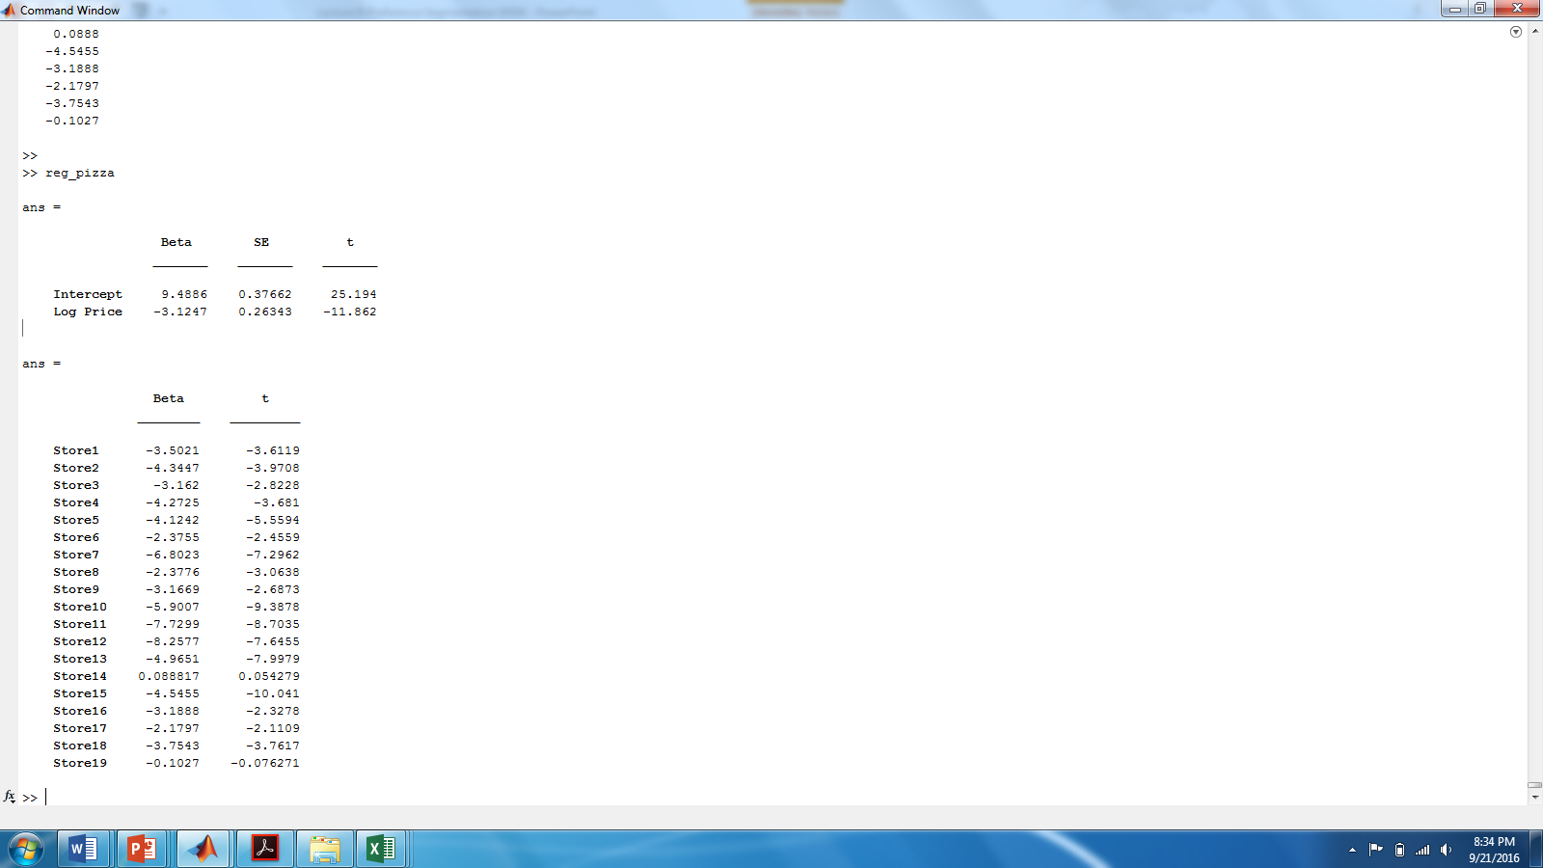
SEGMENTATION
Estimated in MATLAB

Slide 38
SEGMENTATION
Sales Variation Across Stores

Slide 39
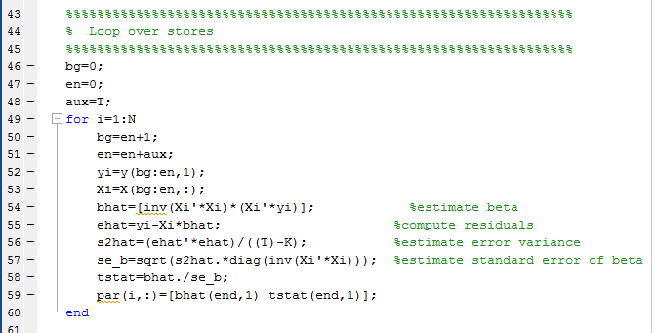
SEGMENTATION
Store-by-Store Regression

Slide 40
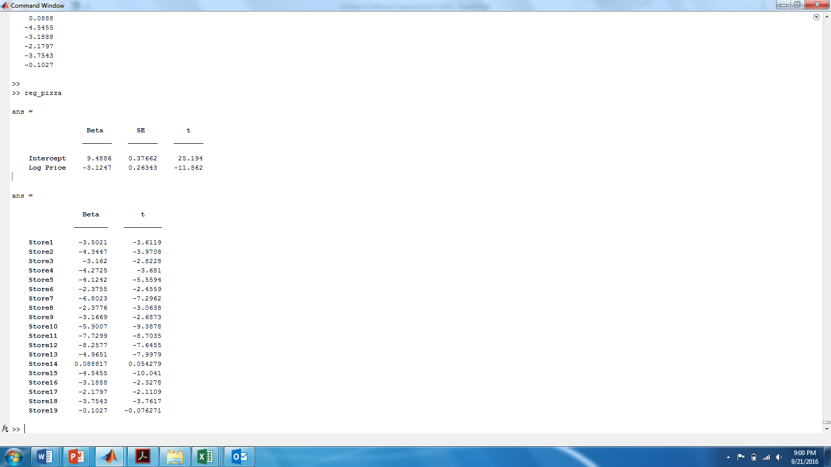
SEGMENTATION
Store-by-Store Regression
Overall Regression

Slide 41
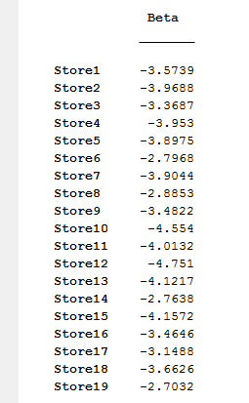
SEGMENTATION
Estimates of Elasticities from Two Models
Store by Store OLS
Hierarchical Bayes

Slide 42
CHOICE BASED CONJOINT DATA
Simulated Market

Slide 43
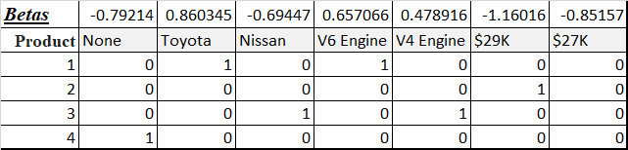
CHOICE BASED CONJOINT DATA
Simulated Market
Compute predicted utilities using betas
Use Logit Rule to predict shares

Slide 44
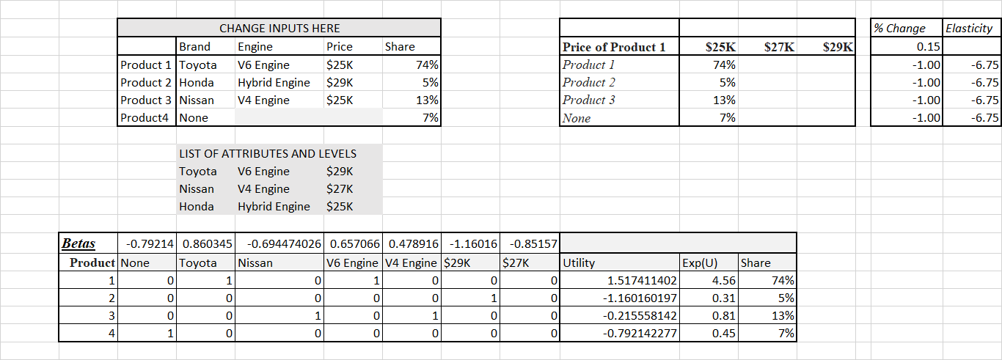
CHOICE BASED CONJOINT DATA
The Logit Rule for Predicted Market Share

Slide 45
CHOICE BASED CONJOINT DATA
The Logit Rule for Predicted Market Share

Slide 46
CONSUMER PREFERENCES FOR FRESH FISH
Choice Based Conjoint Study
Attributes and Levels

Slide 47
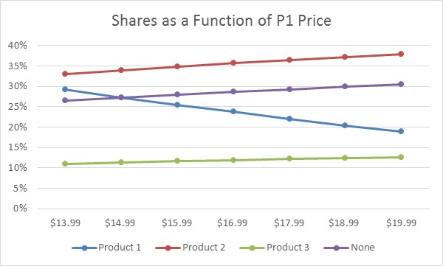
USING THE MODEL
SHARE GRAPHS
P1 is Wild Tuna
P2 is Wild Salmon (15.99)
P3 is Farm Raised Salmon (13.99)

Slide 48
USING THE MODEL
OWN AND CROSS PRICE ELASTICITIES

Slide 49
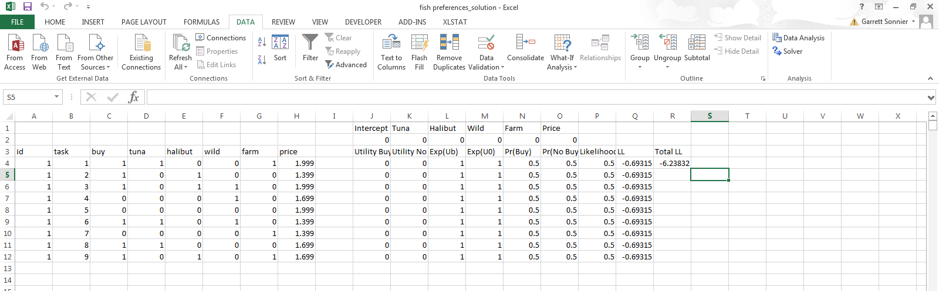
USING THE MODEL
Person by Person MLE for Choice

Slide 50
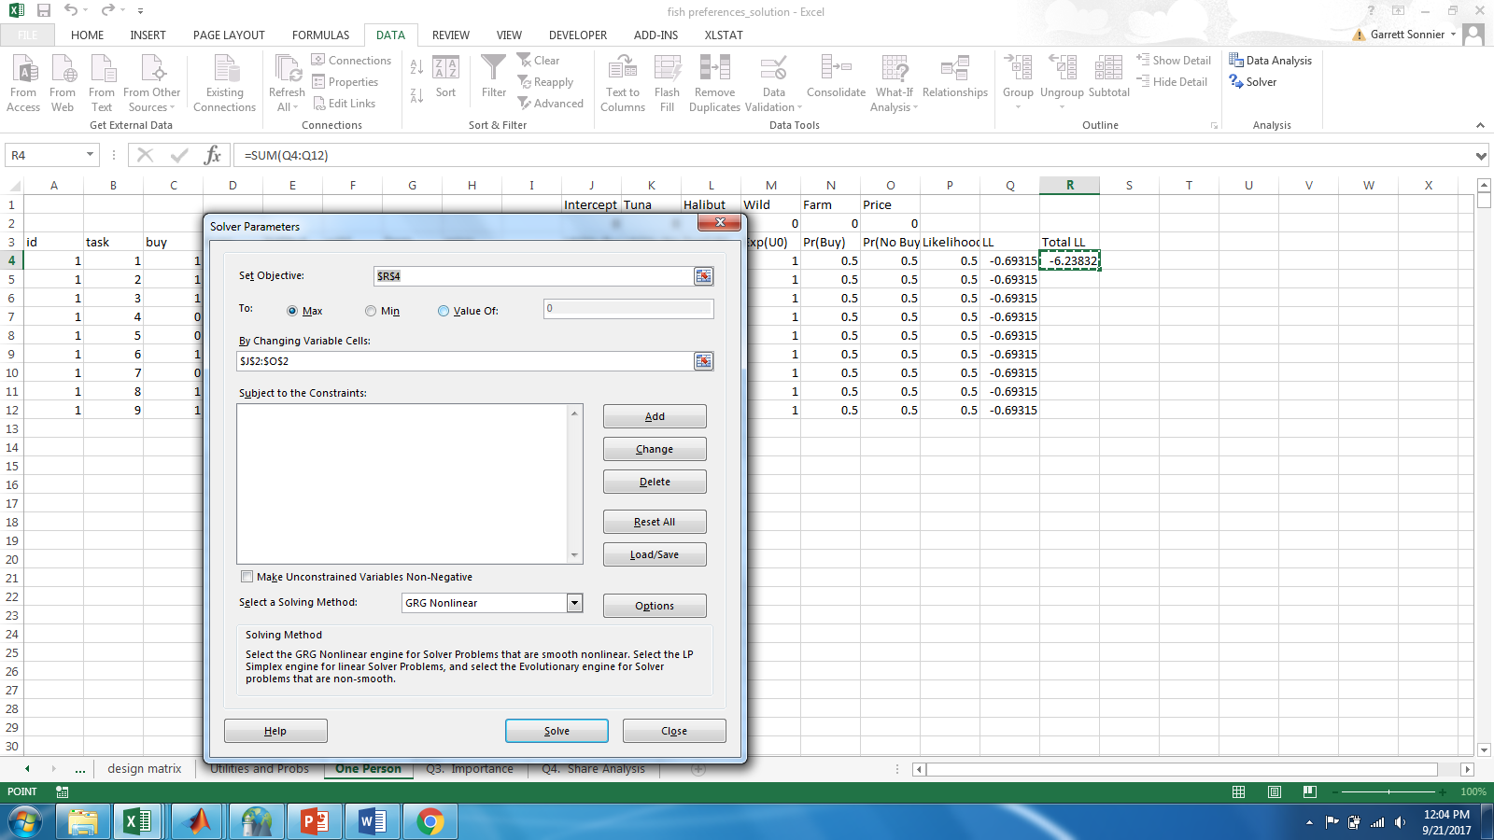
USING THE MODEL
Person by Person MLE for Choice

Slide 51

USING THE MODEL
Person by Person MLE for Choice

Slide 52
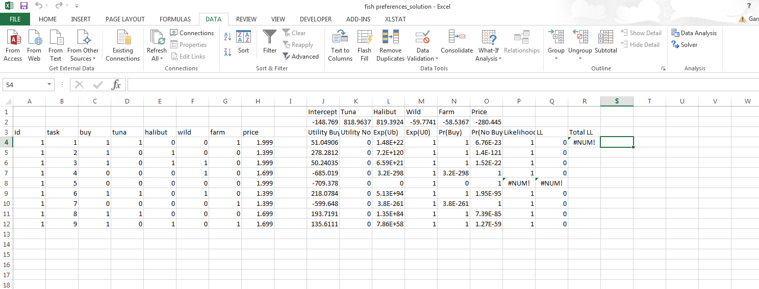
USING THE MODEL
Person by Person MLE for Choice

Slide 53
A HIERARCHICAL MODEL OF CHOICE
Individual Specific Betas

Slide 54
A CHOICE MODEL WITH INDIVIDUAL LEVEL COEFFICIENTS
How to Estimate this Model
The likelihood of your observed data given your parameters
X
Your prior beliefs about the value of the parameters
The posterior distribution of the parameters given the data

Slide 55
A CHOICE MODEL WITH INDIVIDUAL LEVEL COEFFICIENTS
Estimates for First 25 Respondents

Slide 56
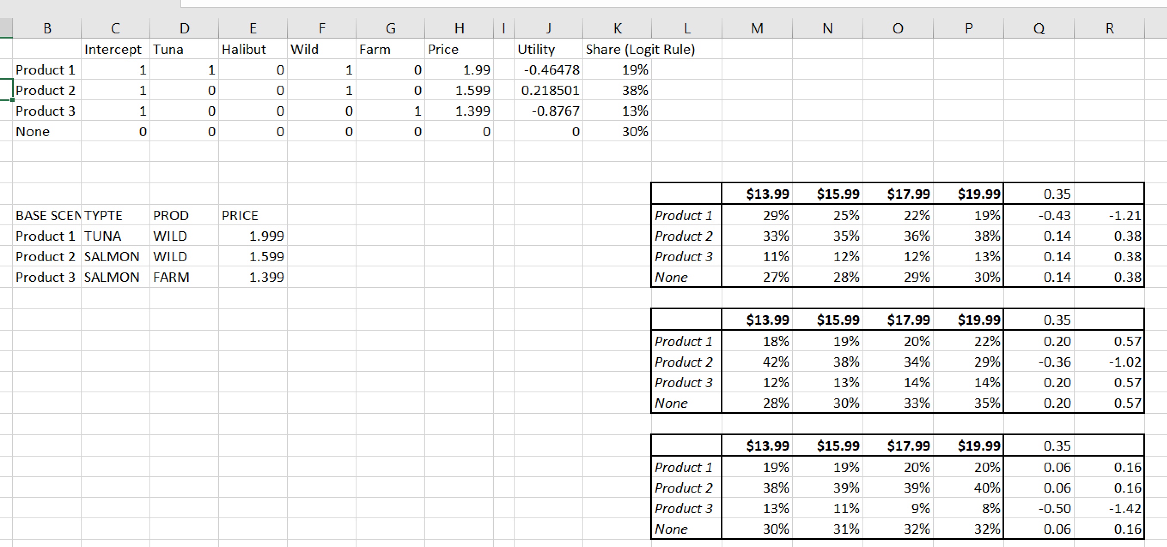
A CHOICE MODEL WITH INDIVIDUAL LEVEL COEFFICIENTS
Back to Our Simulated Market

Slide 57
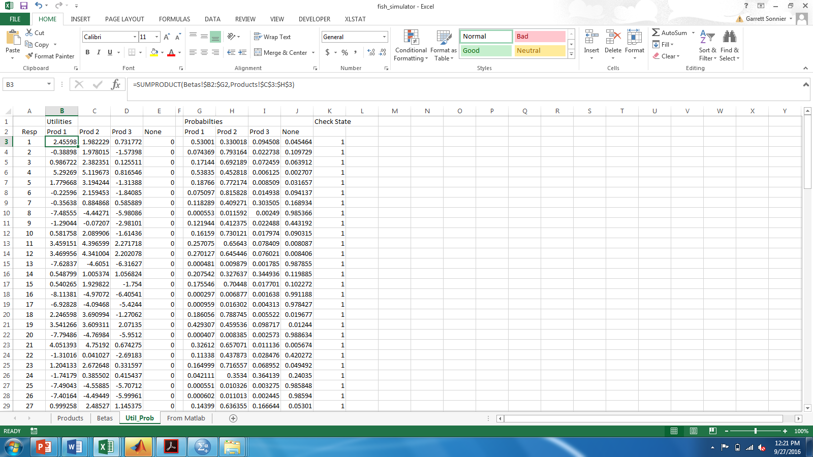
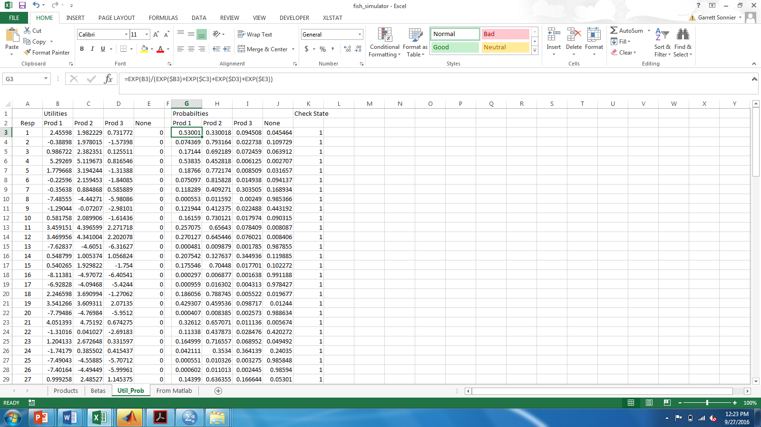
A CHOICE MODEL WITH INDIVIDUAL LEVEL COEFFICIENTS
Utilities and Probabilities

Slide 58
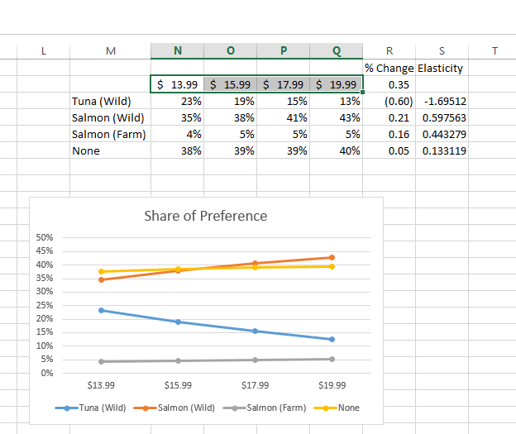
A CHOICE MODEL WITH INDIVIDUAL LEVEL COEFFICIENTS
Shares

Slide 59
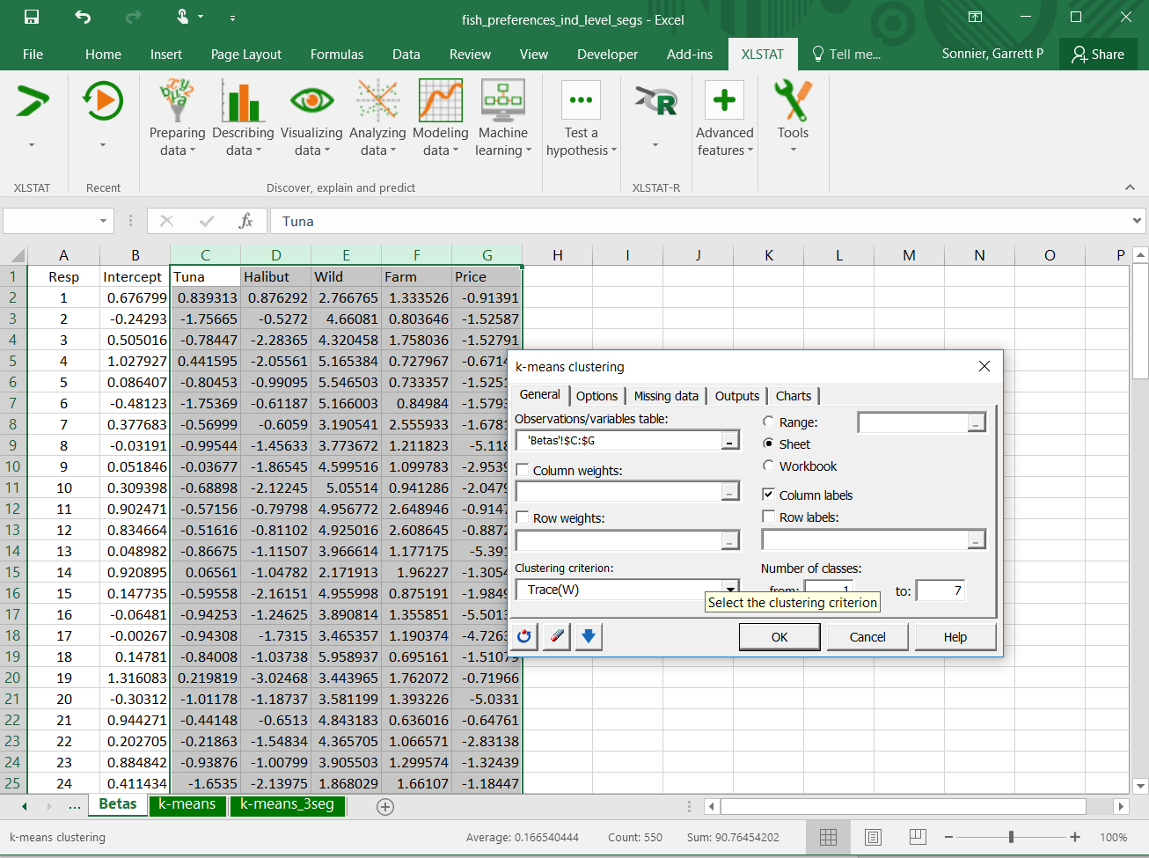
A CHOICE MODEL WITH INDIVIDUAL LEVEL COEFFICIENTS
Segmenting the Market

Slide 60
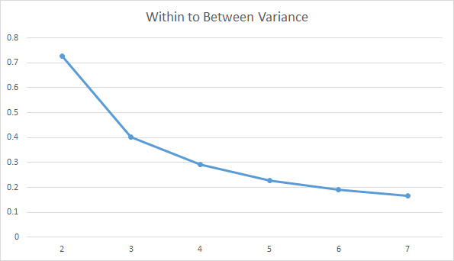
A CHOICE MODEL WITH INDIVIDUAL LEVEL COEFFICIENTS
Segmenting the Market
Ratio of Within to Between Variation
Number of Segments

Slide 61
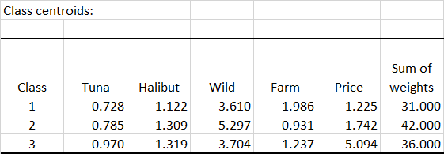
A CHOICE MODEL WITH INDIVIDUAL LEVEL COEFFICIENTS
Segmenting the Market

Slide 62
MARKETING ANALYTICS
Key Concepts for Class Exercise
We can segment consumers on the basis of their preferences
Stated Preferences
Revealed Preferences
Individual level data tells us about differences across customers
Aggregate analysis gives us more statistical reliability, but at the cost of treating all units (i.e., customers or stores) the same
HB analysis is a tool to combine both sets of information
Unit level information (the individual data)
Information about all units (the prior)

Slide 63
